Slide 1
Opioid Settlement Advisory Council update

Slide 2
Principles for the Use of Funds From the Opioid Litigation
1. Spend money to save lives.
2. Use evidence to guide spending.
3. Invest in youth prevention.
4. Focus on racial equity.
5. Develop a transparent, inclusive decision-making process.

Slide 3
Nine Core Abatement Strategies
• Broaden access to naloxone
• Increase use of medications to treat opioid use disorder
• Provide treatment and supports during pregnancy and the
postpartum period
• Expand services for neonatal opioid withdrawal syndrome
• Fund warm hand-off programs and recovery services
• Improve treatment in jails and prisons
• Enrich prevention strategies
• Expand harm reduction programs
• Support data collection and research

Slide 4
Needs Assessment
DAC Street Outreach Survey
Completed by people using a substance or in some treatment
Community Focus Groups
Key informants
1st responders
Behavioral health professionals
Harm reduction services
Town Hall Forums
Chaparral & Hatch
DAC, NM and national substance use and treatment data

Slide 5
Top Three Priorities
Based on NMSU report, asset map, workshop feedback
MOUD and other OUD treatment
Prevention Programs
Expanding Warm Handoff Programs

Slide 6
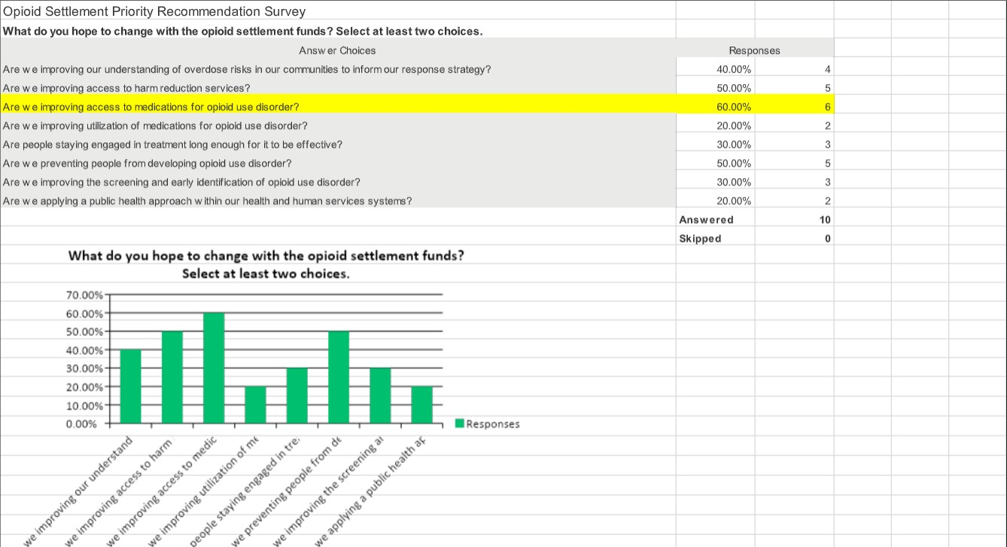

Slide 7
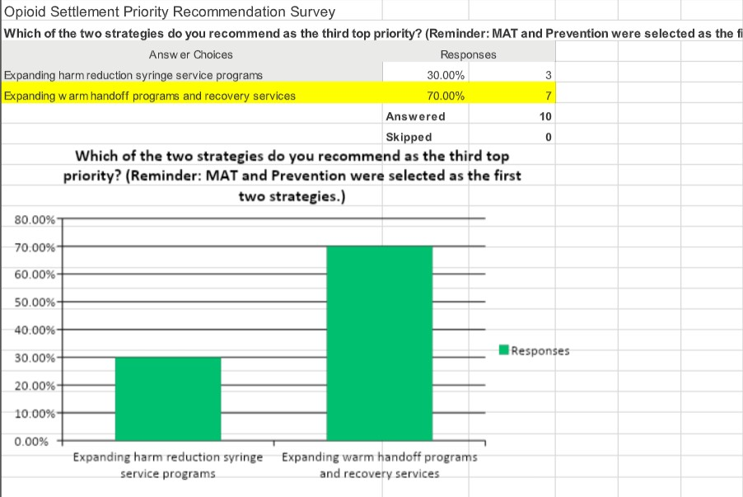

Slide 8
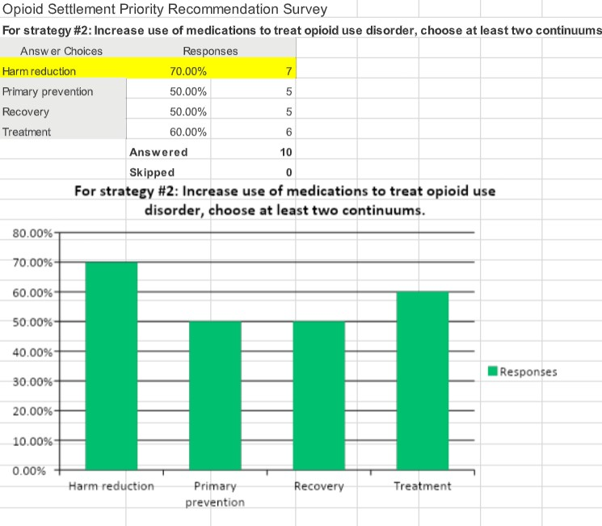

Slide 9
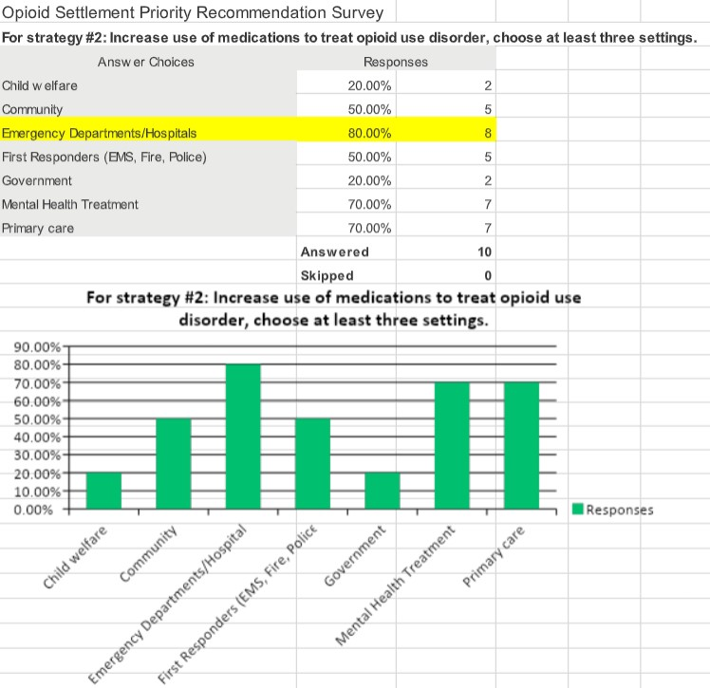

Slide 10
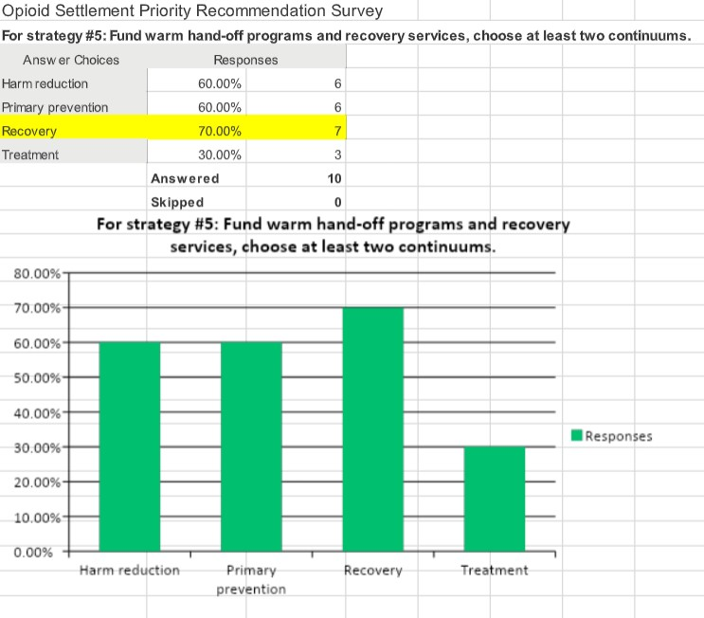

Slide 11
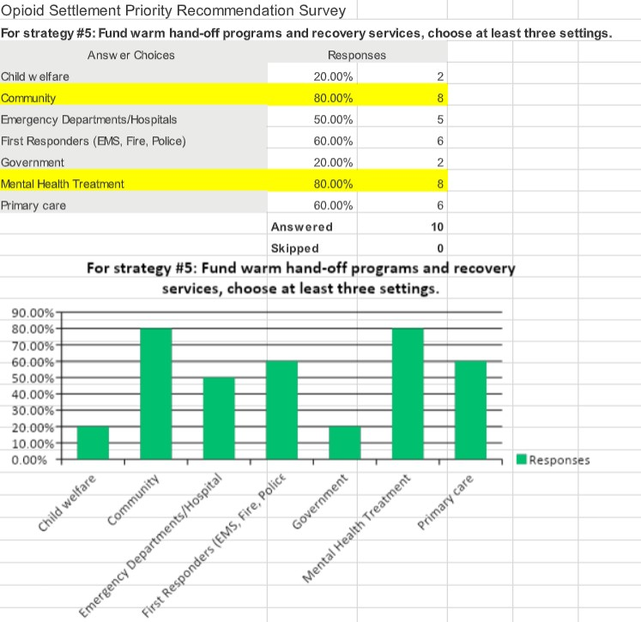

Slide 12
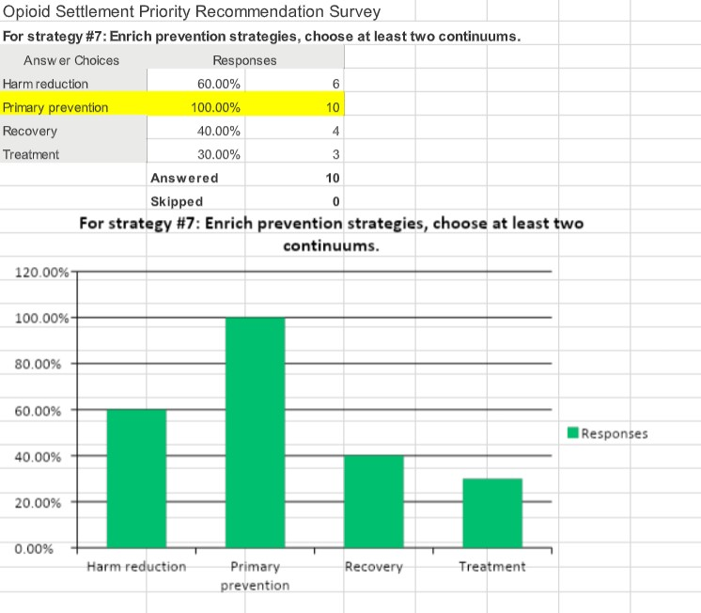

Slide 13
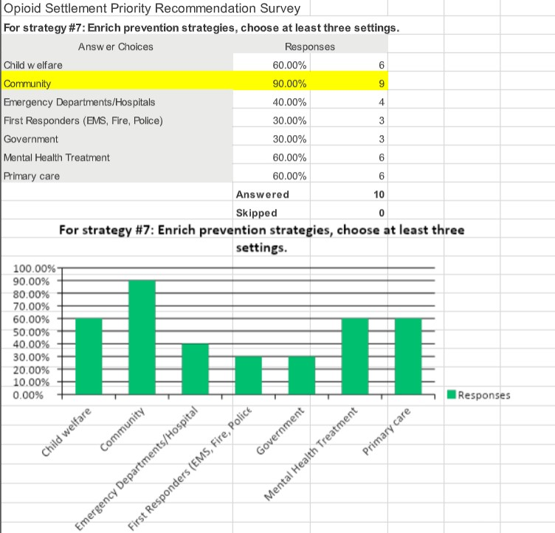

Slide 14
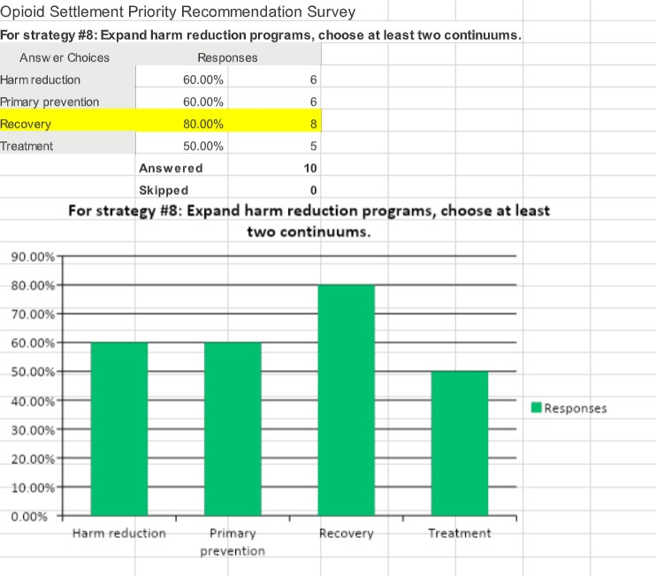

Slide 15
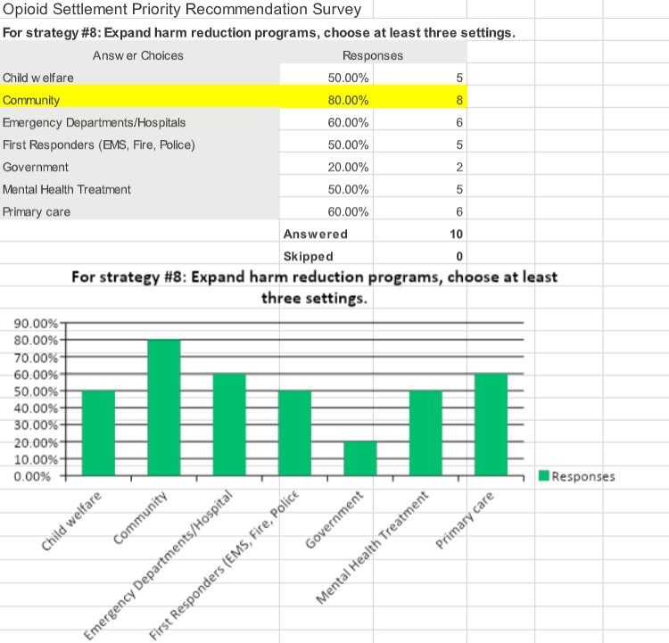

Slide 16
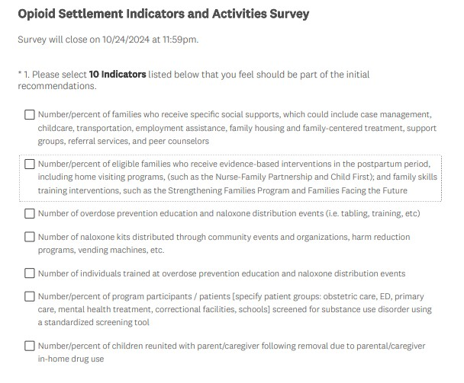

Slide 17
Opioid Settlement Indicators and Activities Survey
https://www.surveymonkey.com/r/DGBDDCS
Opioid Settlement Indicators and Activities Survey

